Slide 1
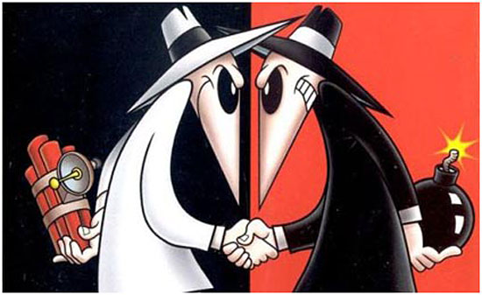
Faded Hats and Scuffed Sneakers
The Ethical Hacker Today
Nick Toothman

Slide 2
To hack: Not just a definition…
Merriam-Webster:
To write computer programs for enjoyment
To gain access to a computer illegally
The term’s historical meaning originated from MIT during the 1950s and 1960s, describing the quick, inelegant solutions to problems or implementation of pranks by a population that would soon be classified as hackers
A hack is not limited to purely software environments

Slide 3
Traditional motivations for hacking
Personal gain
Activism or moral objection
True, honest-to-goodness concern for security and protection

Slide 4
The hacker
One that hacks
An expert at programming and solving problems with a computer
A person who illegally gains access and sometimes tampers with information in a computer system
“Look at you, hacker. A pathetic creature of meat and bone, panting and sweating as you run through my corridors. How can you challenge a perfect, immortal machine?”
SHODAN, System Shock 2

Slide 5
The teams
“True” hackers are most commonly classified into three distinct classifications based on their personal ideologies
Sorry, no room for script kiddies

Slide 6
The black hat
Considered the “villain” type of hacker
Seeks unauthorized access to systems without acquiring legal permission
Motivation is for personal benefit
Material wealth (creating spambots and botnets, acquiring lucrative information, blackmail)
Vendetta (website defacement or vandalism just for fun)

Slide 7
The white hat
“Vigilante” type of hacker
Still operates illegally unless otherwise stated
Seeks out security flaws and vulnerabilities not for exploitation, but so that their discovery will result in their correction, benefitting the common good
This includes both the hacker community and the afflicted party, and eventually the entire population

Slide 8
Dangerous territory: the grey hat
(As expected) The middle ground between white and black hat hackers
True neutral in terms of D&D alignment (prior to 4th Ed.)
Utilizes ideologies from both sides to satisfy personal endeavors
Out of the three, grey hats are most often faced with ethical dilemmas when exploits are discovered
Due to the dual nature of the grey hat hacker, this group is often seen as the one true hacker

Slide 9
Distinction between the groups
Assuming equal levels of skill, knowledge, and opportunity between the groups, what sets them apart?
Identify the limitations that each group has to make use of their skills and knowledge
From this, we can explore the justifications for the limitations that each group possesses.
The justifications found thus characterize the hacker and their motivation

Slide 10
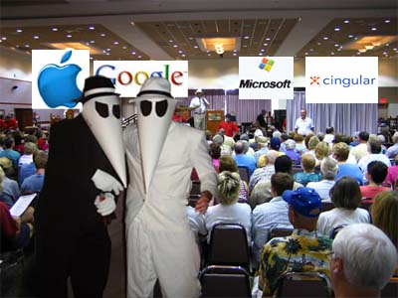
Hacker Motivations (A summary)
Black hat: “It’s their own fault.”
White hat: “Yeah, but it’s our responsibility to help them.”
Grey hat: “I want to help, but I don’t want to get in trouble…”
Not pictured: Grey hat

Slide 11
The ethics behind everything
The distinctions between the hacker groups can grow fuzzy are flexible as laws change
However, the underlying, personal philosophies behind each group are distinct enough to identify and appreciate the central topic of this discussion: the ethical hacker

Slide 12
Software Engineering Code of Ethics and Professional Practice
The ACM and IEEE have agreed upon a code of ethics for software professionals:
1. PUBLIC - Software engineers shall act consistently with the public interest.
2. CLIENT AND EMPLOYER - Software engineers shall act in a manner that is in the best interests of their client and employer consistent with the public interest.
3. PRODUCT - Software engineers shall ensure that their products and related modifications meet the highest professional standards possible.
4. JUDGMENT - Software engineers shall maintain integrity and independence in their professional judgment.
5. MANAGEMENT - Software engineering managers and leaders shall subscribe to and promote an ethical approach to the management of software development and maintenance.
6. PROFESSION - Software engineers shall advance the integrity and reputation of the profession consistent with the public interest.
7. COLLEAGUES - Software engineers shall be fair to and supportive of their colleagues.
8. SELF - Software engineers shall participate in lifelong learning regarding the practice of their profession and shall promote an ethical approach to the practice of the profession.

Slide 13
The Hacker Ethic
Definitions vary between hacker to hacker, philosopher to philosopher, etc.
Generalized tenets that represent the ethic:
Sharing
Openness
Decentralization
Free access to computers
World improvement

Slide 14
The Hacker Ethic
Unlike SE Code of Ethics, the Hacker Ethic is a byproduct of the community it serves
The Hacker Ethic sounds and looks commendable to any software engineer or tech enthusiast… so why are hackers still fully associated with illegal activity?

Slide 15
Examples of following the Hacker Ethic (or, how to earn a bad rep.)
Sharing: P2P development (Gnutella network)
Piracy
Openness: cracking closed-source software and removing copyrighted obfuscation
Breaks EULA
Decentralization: BitTorrent P2P Protocol
Piracy

Slide 16
Examples of following the Hacker Ethic (or, how to earn a good rep.)
Free access to computers: developing free software for cheap hardware
OLPC movement
World improvement: raising awareness of crises all across the world
VIM’s dedication to aiding children in Uganda

Slide 17
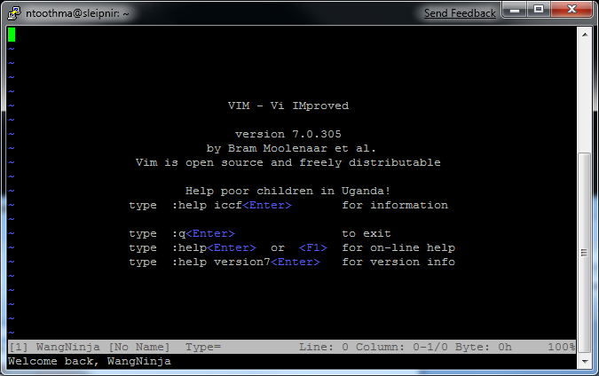
Way to go, VIM!
Don’t let anyone ever tell you pico is better. Or emacs (Sorry, emacs fans)

Slide 18
So, what went wrong?
The very nature of the hacker is to explore beyond the given boundaries.
With exploration comes discovery and invention
Newer hacking tools or newly-discovered bug exploits can be utilized by individuals not so keen on following the Hacker Ethic
The hacker receives equal blame with the offender, and worse yet, equal association

Slide 19
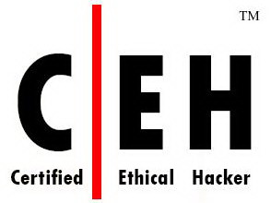
What went right?
To continue benefitting from the discoveries and good intentions of the white hat hacker while differentiating them from the black hat (and offering legal protection), the technology industry turned to its de facto solution: certification!
An individual possessing the title of a Certified Ethical Hacker (offered by the EC-Council) can be safely contracted to test the security of a given system without fear of legal action. Moreover, the contractor now has someone to hold responsible should anything go wrong.

Slide 20
But does it stack up?
The use of a CEH in a particular business is almost always beneficial for the health and safety of both its employees and its customers
However, this course of action has led to the creation of the controlled black hat hacker, not the preservation of the white hat hacker in a corporate environment. The CEH still performs the same malicious attacks, but acquires personal gain through a salary rather than unhindered access to lucrative information.
Still, while the motivation and use of a CEH does not adhere to the hacker ethic, it does not necessarily violate the tenets to a large degree.
Note: in a free, open-source environment, these disadvantages are no longer valid. Good luck hiring a CEH for free, though.

Slide 21
The hacker community
The hacker’s strongest tool
Provides a perpetual source of shared information and development
The shared voice of many is stronger than the cry of one.
Offers a friendlier, more sociable image of the hacker compared to the “lone wolf” nerd stereotype
The best hope for saving the ethical hacker
Only persistent involvement in the community for a practice as dynamic as hacking can preserve and uphold the knowledge history that helped defined the hacker ethic

Slide 22
Getting involved
Conferences
HOPE
Pwn2Own
Determine security of the latest platforms and technologies and earn marvelous cash prizes!
Publications
2600: The Hacker Quarterly
Recently released The Best of 2600 [A Hacker’s Odyssey]

Slide 23
More info
http://cansecwest.com/
http://www.2600.com/
http://www.eccouncil.org/ceh.htm
http://blog.wired.com/27bstroke6/2009/02/ifpi-site-hacke.html
http://www.acm.org/about/se-code
http://mitya.pp.ru/chamberlen/hackers/cover.html for Hackers: Heroes of the Computer Revolution

